Slide 1




Pi-Mates
HACKTOBERFEST 1.0

Slide 2






Movie Recommendation System
The problem our movie recommendation system aims to solve is the overwhelming choice and decision fatigue experienced by consumers when selecting a movie to watch. This problem is important and relevant to our target audience because it directly addresses the challenge of finding enjoyable content in an era of abundant streaming services and countless movie options.
According to a Deloitte Digital Media Trends survey in 2021, 51% of U.S. consumers were overwhelmed by the number of streaming services and content choices available. Another study by Hub Research found that 38% of viewers spent more time deciding what to watch than actually watching content. This indicates a significant demand for a solution that can streamline the decision-making process and offer personalized movie recommendations to enhance the viewing experience.

Slide 3




Solution
In short, our business model solves the overwhelming movie choice problem with personalized recommendations, content aggregation, and user engagement. We also incorporate a social impact component, making it a sustainable solution for the tech industry.
Our innovative business strategy offers the following solutions:
Personalized Movie Recommendations:
2. Content Aggregation:
3. User Engagement:

Slide 4


Key Features and Functionality
Our system offers a user-friendly interface with intuitive navigation and a powerful search function for easy content discovery.

Slide 5


Social impact
Social Impact Goals:
Promote diversity in film
2. Foster a strong film community.
Measuring Social Impact:
Track underrepresented content.
2. Measure community engagement.

Slide 6


Revenue Model
Revenue Model:
- Pay – per – click advertising
- Content Partnerships
Social Impact:
Promoting diversity in film.
2 Building a strong film community.
Our business model creates a better world by fostering inclusivity, sustainability, and community in the film industry.

Slide 7



Technologies Used
OUR TEAM UTILIZED A VARIETY OF TECHNOLOGIES INCLUDING PROGRAMMING LANGUAGES LIKE AND PYTHON FOR BACKEND DEVELOPMENT AND HTML,CSS FOR FRONT END, AS WELL AS TOOLS LIKE GITHUB AND PANDAS

Slide 8

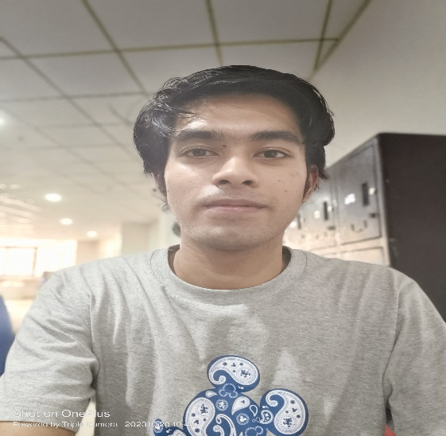
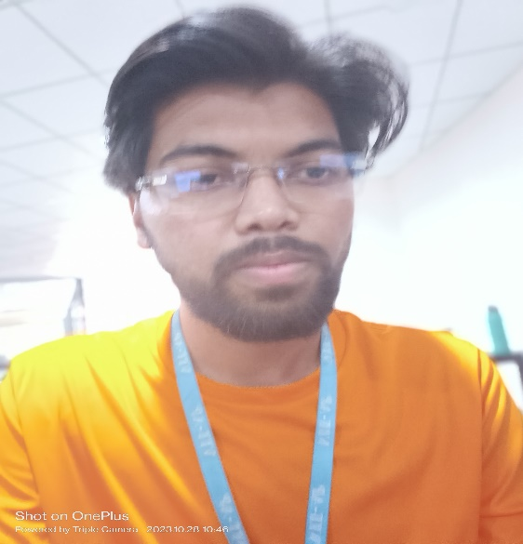
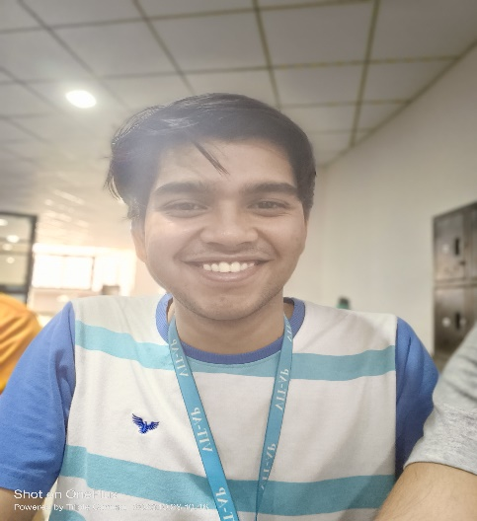
The Team
Tarush
Saxsena
Vansh Rawat
Kartikay Singh
developer
developer
developer

Slide 9


Thank You
HACKTOBER FEST

